Slide 1

A BITE of BIG DATA
Group name: Fin-pro
Group Members:
17441781 CHEN Yanhua
17438578 LIU Wanyin
17408067 PENG Yu
17422353 GAO XING
COMM7780/ JOUR7280

Slide 2
Content
Data source: Xiachufang (下厨房)
24 Hours Popular Dishes in Xiachufang
The star recipes and star users in a week
Foreign Recipes in Xiachufang
The relationship of Chinese cuisines

Slide 3
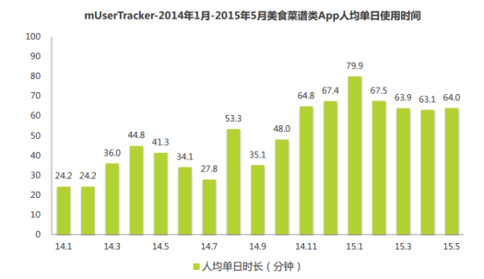
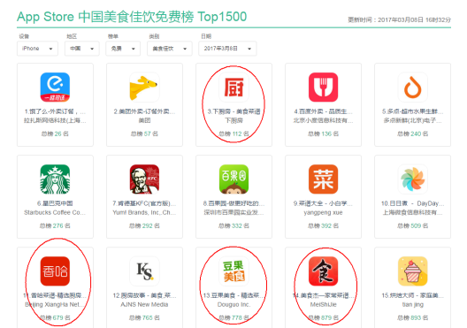
Data source: Xiachufang (下厨房)
图1 2014.1-2015.5美食菜谱类App人均单日使用时间 数据来源：艾瑞咨询
图2 AppStore美食佳饮排行榜前15总览 数据来源：AppSto
Xiachufang is a UGC platform, on which people could share their creative recipes and others could make the same cuisine by following the recipe.
The communication atmosphere is well-established by operators and supported users.
People who chasing better quality of life attracts by its decent style.
Its DAU is 6 million and it has many loyalty fans.

Slide 4
1. 24 Hours Popular Dishes in Xiachufang

Slide 5
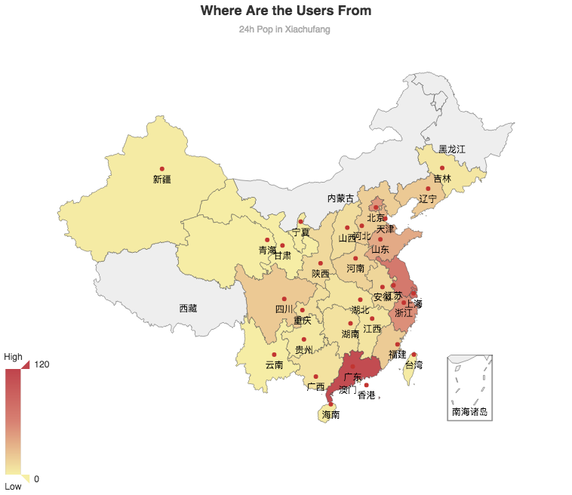
1.Most of their users come from economic developed area.
2.Top 3 of them are Guangdong, Shanghai and Jiangxu.
3.The trend in the heat map fits the China Engel‘s coefficient (恩格尔系数)2017 statistics.
江苏
61
上海
72
Insights：
1.Along with the consumption upgrading trend, people are not only interested in eating good food, but also making good food by themselves.
2.People are willing to share their good dished and gain the attention from others.
3.If you want to open a restaurant or combine the online and offline market, this map may be helpful.
广东
114
Map From Echarts Gallery :http://gallery.echartsjs.com/editor.html?c=map-china-dataRange

Slide 6
2. A glimpse of popular recipes in a week

Slide 7

We scraped 880 recipes in the weekly popular list.
And analyze the various materials. We can see that the most frequently used materials are flour, eggs and butter.

Slide 8
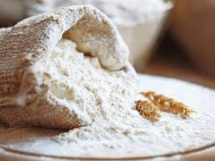
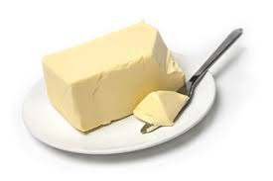
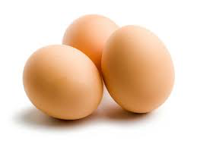
When these three materials appear at the same time, do these remind you of something?

Slide 9
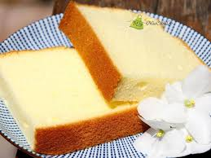
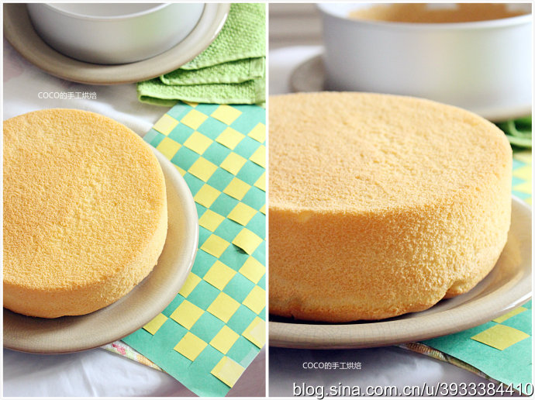
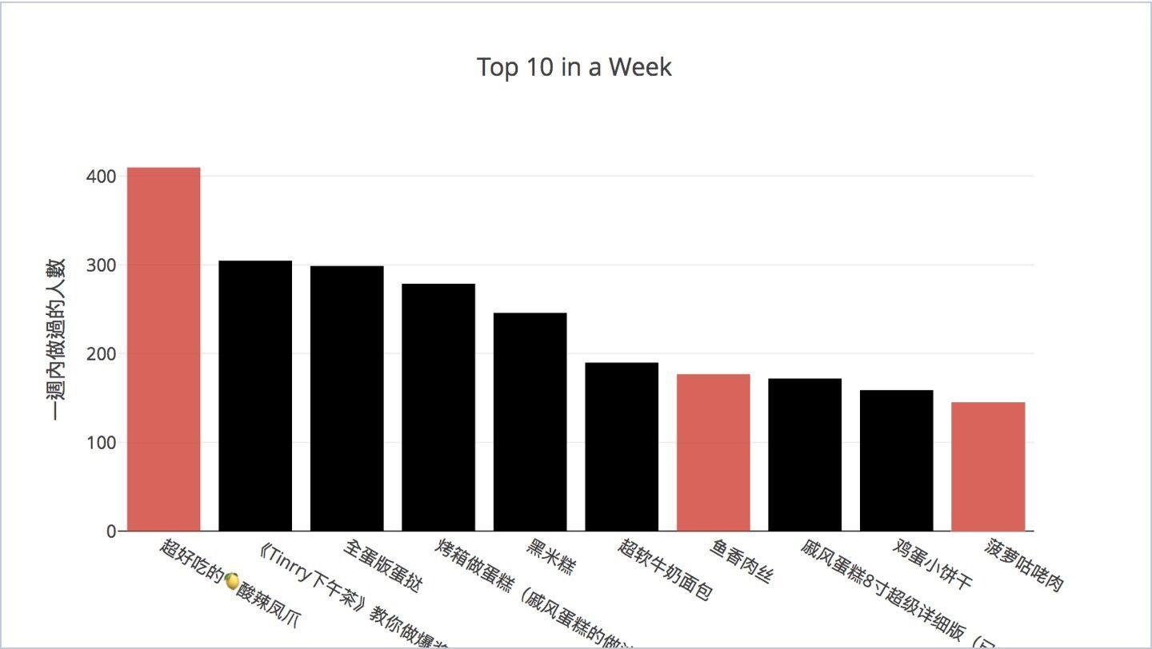
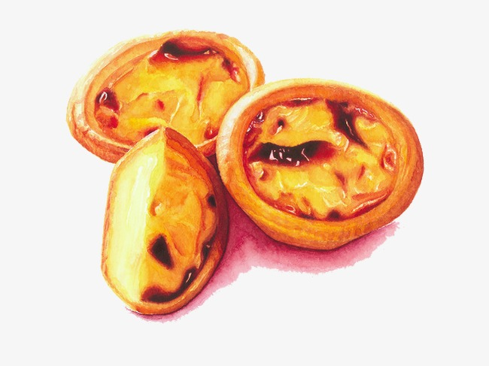
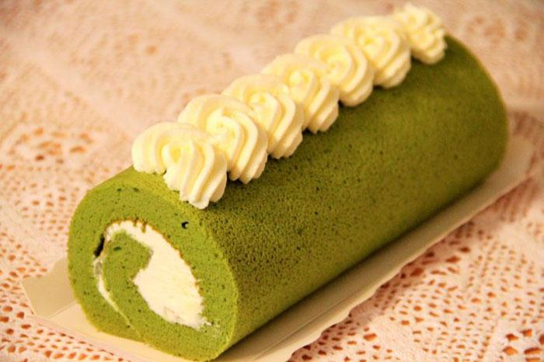
Here comes the dessert…

Slide 10
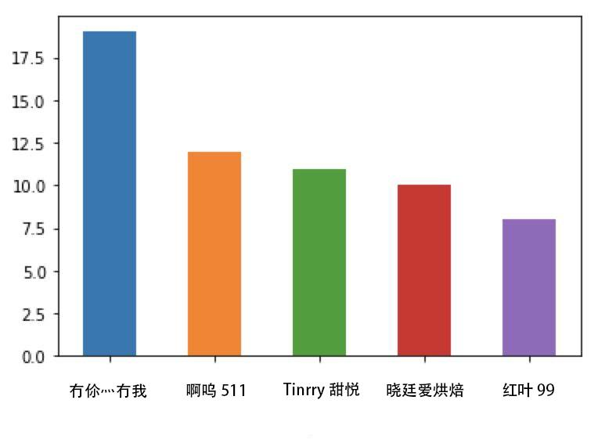
Let’s see the most welcome blogger.
The number shows the frequency of the bloggers’ recipe appearing in the whole rank.
Frequency of occurrence in a week
Users

Slide 11
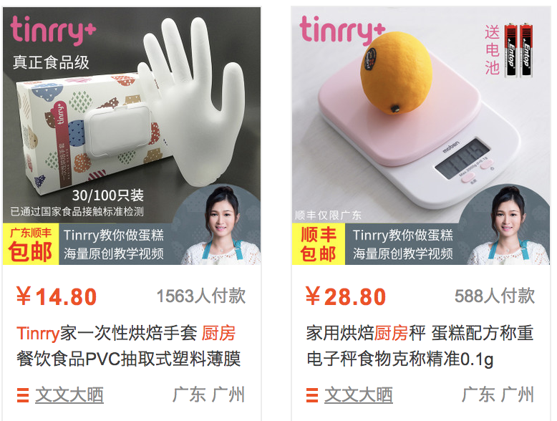
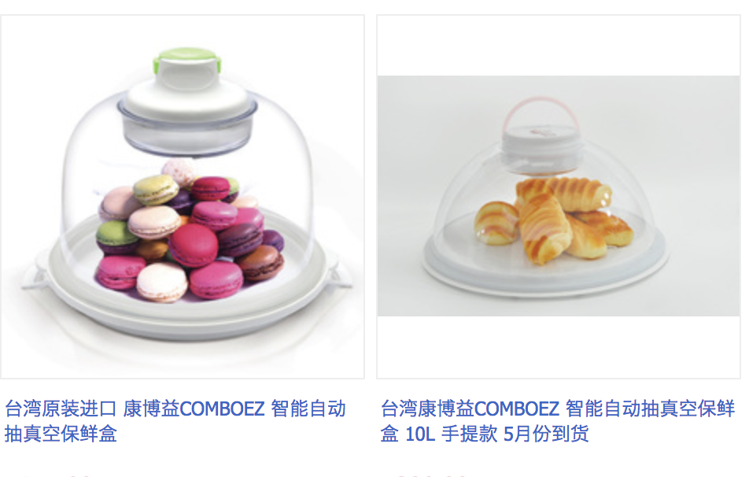
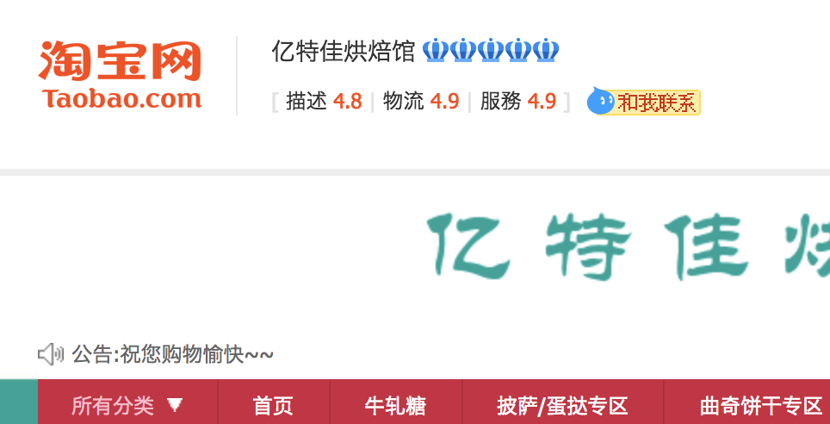
https://tinrry.world.taobao.com/?spm=2013.1.1000126.3.3dbd6165EKP0dX
Frequency of occurrence in a week
Users
Three of them have their own ‘Taobao’shops.
https://shop34384559.world.taobao.com/?spm=a230r.7195193.1997079397.26.3UOUoq
https://shop143766469.world.taobao.com/shop/view_shop.htm?spm=a1z0k.1000780.1997989141.d4915209.R8OazC&shop_id=143766469

Slide 12
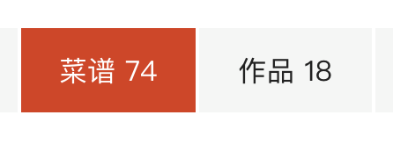
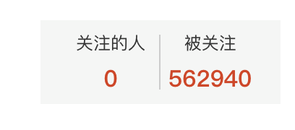


三百六十行，行行出‘网红’
Every industry has its own internet celebrities
we can see the data from Xiachufang, the 3rd user only has 74 recipes, and just posted 18 work she had done before. However, she is followed by 562940 fans which is quite arresting
After visiting this blogger own website http://www.tinrry.com, we found that she has her own YouKu channel and Weibo account.
More than 227 thousand people subscribed her channel ,and she has 871428 followers on Weibo. So we can say she is the Internet celebrity on Xiachufang.

Slide 13
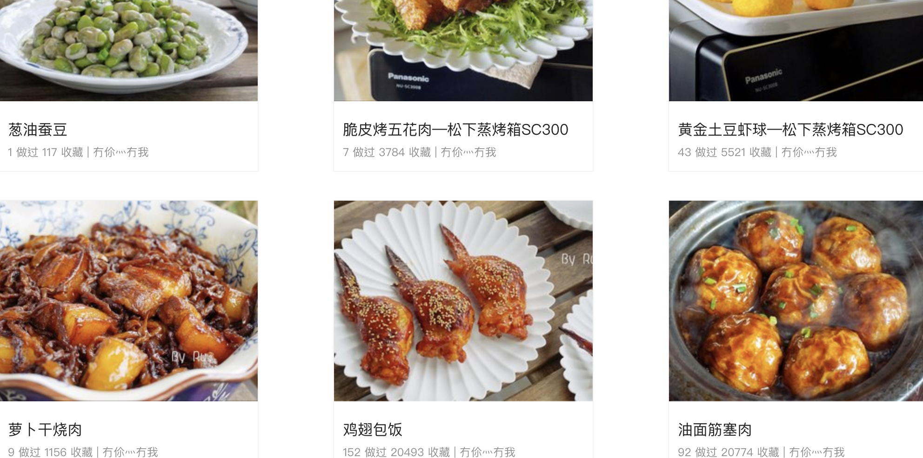
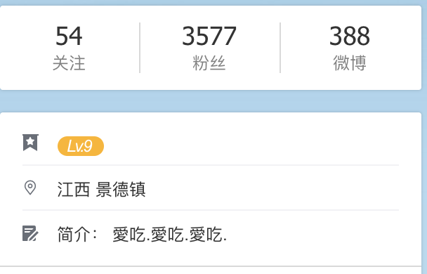
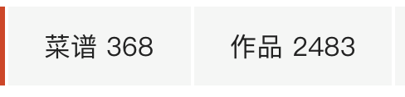
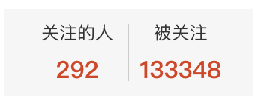
There is someone who is not as famous as the celebrate，and just love cooking.
Top one user ‘冇伱灬冇我 ’ is people’s choice who can really do delicious dishes. Since she is the only one who do not only bake food but do all kinds of dishes. Although she is not as popular as the other four people on the list, her recipes are still the most popular.

Slide 14
If you want to be famous, just bake it;
If you want to cook, just enjoy it.

Slide 15
3. Foreign Recipes in Xiachufang

Slide 16
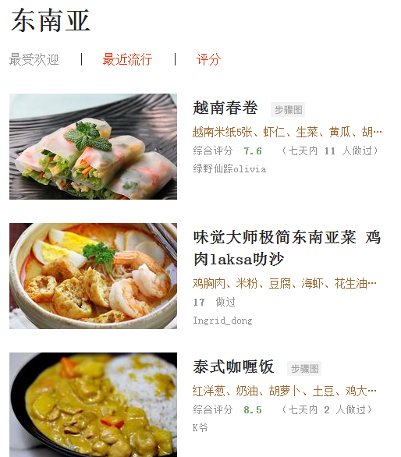
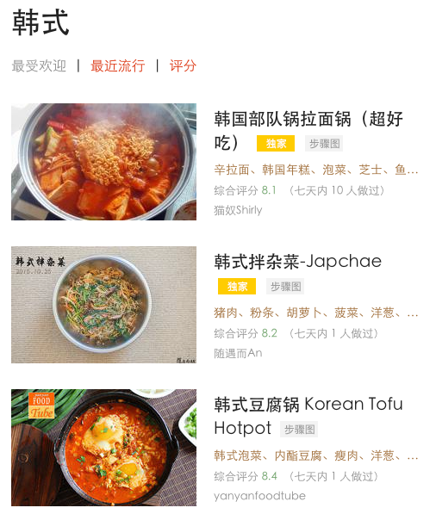
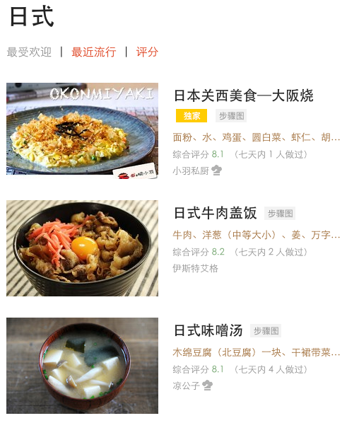
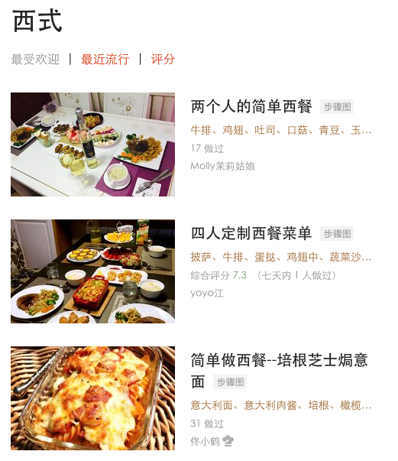
3. Southeast Asian, Korean, Japanese and Western Recipes in Xiachufang

Slide 17
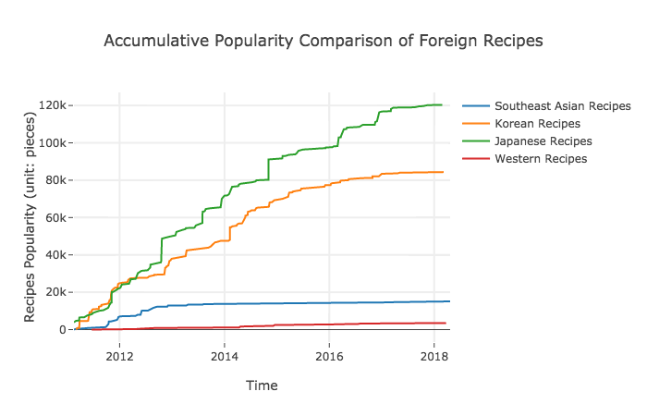
The Accumulative Popularity Trend of
Southeast Asian, Korean, Japanese and Western Recipes
1. The Japanese and Korean recipes are very popular in Xiachufang.
2. Southeast Asian recipes have a great increase during 2011 to 2013. After 2014, they appear to be steady and slow.
3. The Western recipes are the least popular foreign recipes in Xiachufang that just a few users have cooked the Western recipes.

Slide 18
The Accumulative Popularity Trend of
Southeast Asian, Korean, Japanese and Western Recipes
1. The Japanese and Korean recipes are very popular in Xiachufang.
2. Southeast Asian recipes have a great increase during 2011 to 2013. After 2014, they appear to be steady and slow.
3. The Western recipes are the least popular foreign recipes in Xiachufang that just a few users have cooked the Western recipes.
Analysis 1: Chinese people tend to cook Japanese and Korean food, which may because of the identity of the similar culture or similar favorite taste.
Analysis 2: Southeast Asian recipes had once been popular for one or two years since the establishment of Xiachufang in 2011 but maybe not many users want to cook Southeast Asian food.
Analysis 3: The reason why Western recipes are not so popular as other recipes may be that it is more difficult to make Western recipes by chinese common-used tools in kitchen.

Slide 19
4. The relationship of Chinese cuisines
Dimensionality Reduction: TSNE

Slide 20
Methodology:Dimensionality Reduction: TSNE
Why use TSNE:
When we examine the relationship of eight Chinese cuisines, and the level of difference and similarity among them, there are thousands of dimensions we need measure, including different materials and different cooking methods. However, If we retain all dimensions, it is hard to visualize it, and furthermore, examine the distribution and relationship of it, giving new insight to data.
"t-SNE" can help to visualizes high-dimensional data by giving each data point a location in a two or three-dimensional map. It is better than existing techniques at creating a single map that reveals structure at many different scales. So we use TSNE to reduce 1389 dimensions into two dimensions and visualize it. In our case, each data point is a single recipe from the Xiachufang.
more info about TSNE:
http://scikit-learn.org/stable/modules/generated/sklearn.manifold.TSNE.html
How we get 1,389 dimensions:
Searching dishes by eight traditional cuisines respectively, we gain 1,497 dishes including name, materials and detail recipes. Splitting materials of total 1,497 dishes, we get a list containing 51,222 words. After removing duplication and setting stop words which can be neither defined as materials nor cooking methods, we gain 1.389 dimensions to measure total 1.497 dishes.

Slide 21
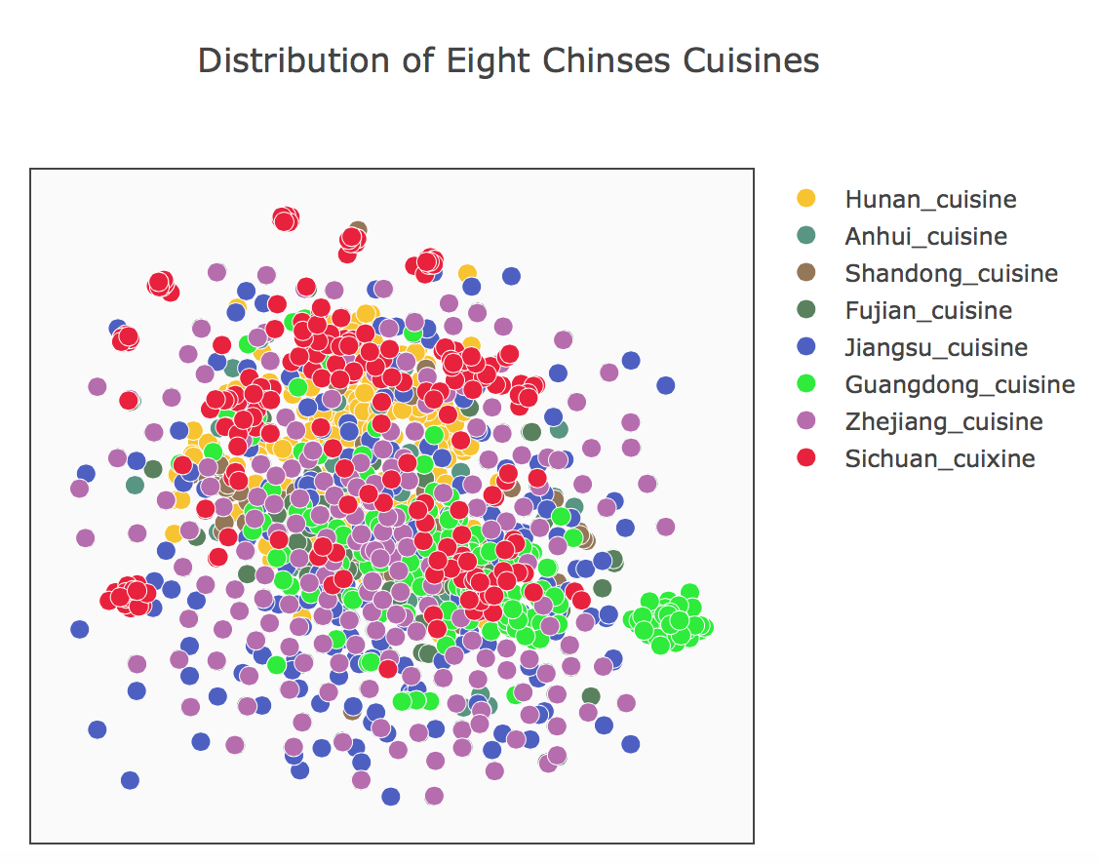
Layout of 1497 Chinese recipes from Xiachufang
Searching dishes by eight traditional cuisines, we gain 1497 dishes including name, materials and detail recipes.

Slide 22
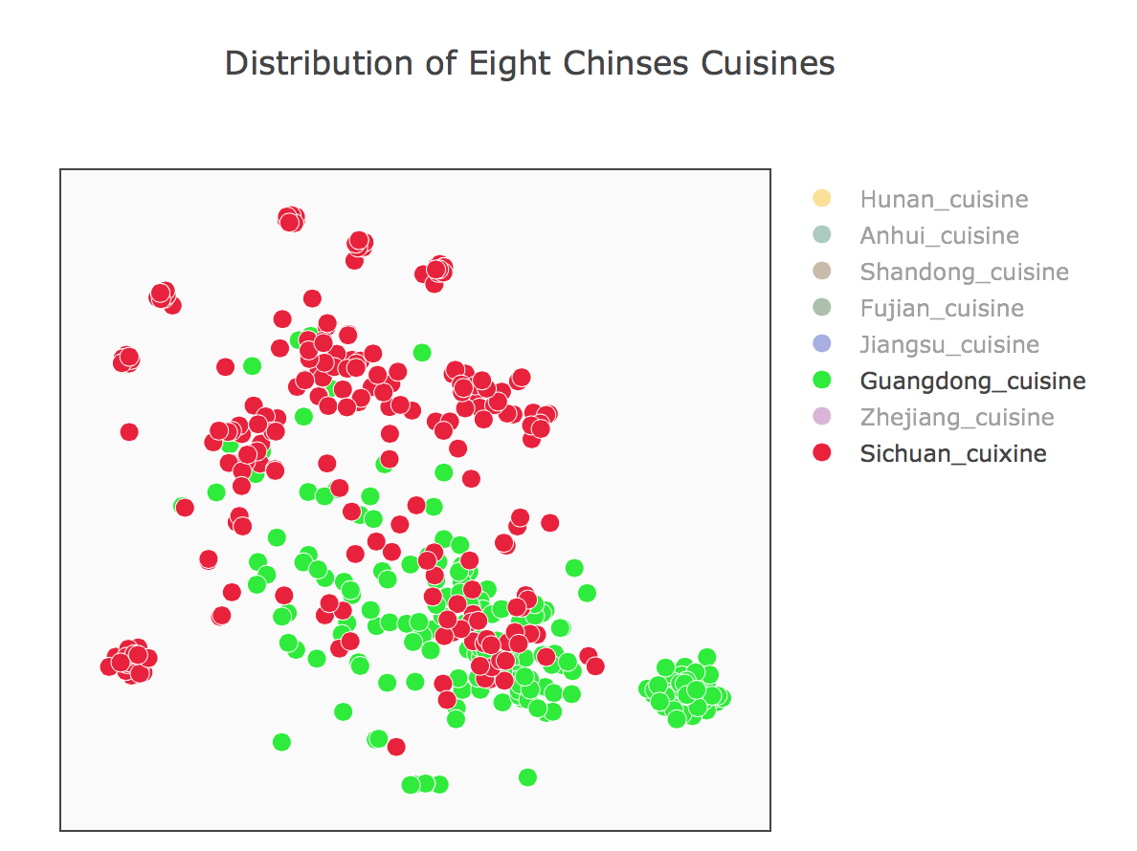
Guangdong cuisine VS. Sichuan cuisine
Data distribution：
Even there are some superposition and close dots, the discrepancy is quite large.
More information：
Besides, compared with Guangzhou cuisine, The distribution of recipe of Sichuan cuisine is more scattered, which means the Sichuan cuisine is more versatile and more diverse.

Slide 23
Guangdong cuisine VS. Sichuan cuisine
The classic dishes in Sichuan cuisine：
Sichuan Pickles（四川泡菜）
The classic dishes in Guangzhou cuisine：
Cantonese mooncake：
1.Validating our previous discussions that dessert-type foods are very popular in Xiachufang.
2.a potentially large number of bloggers sell desserts in Xiachufang.
Diced Chicken in Chilli Sauce
宫爆鸡丁
Cantonese mooncake
Sichuan Pickles

Slide 24
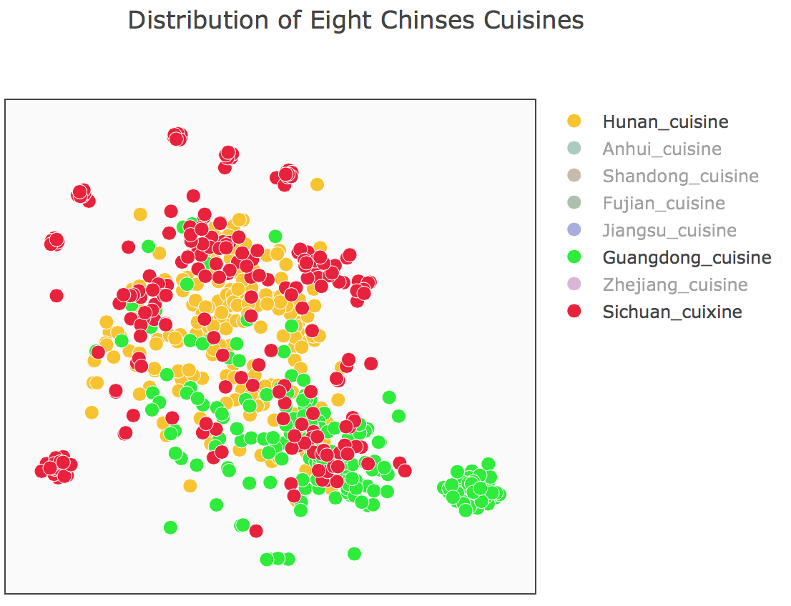
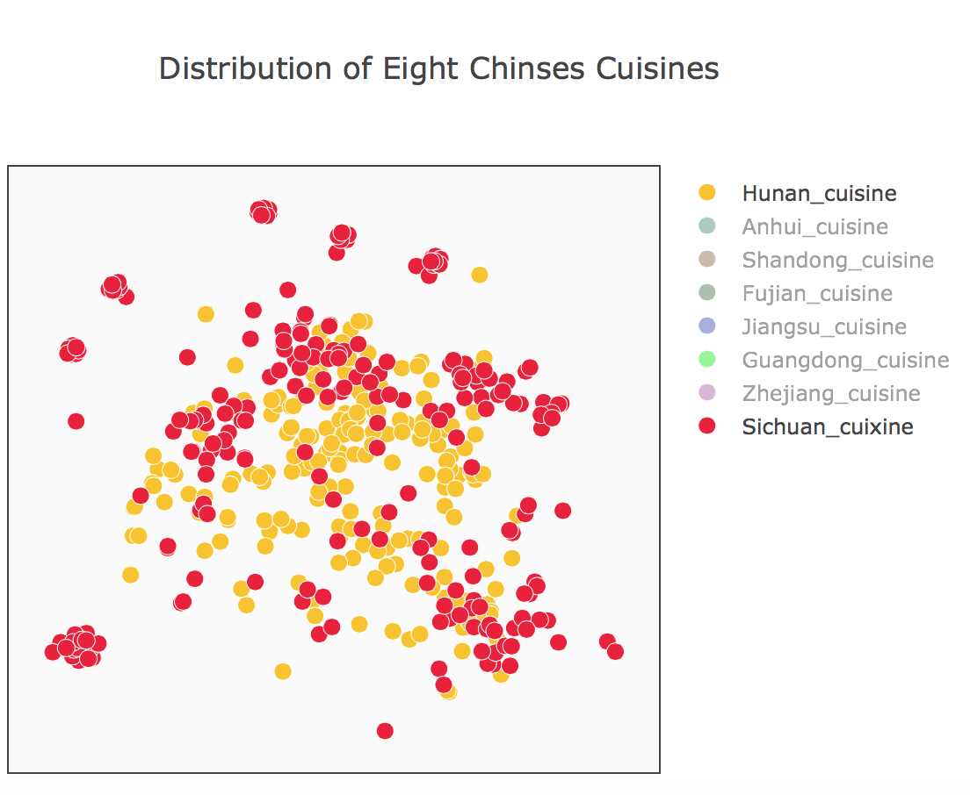
Sichuan cuisine VS. Hunan cuisine
The recipes of Hunan cuisine and Sichuan cuisine are closer in the map.
Besides, compared with Sichuan cuisine, The distribution of Hunan cuisine is more concentrated.
Still, Sichuan recipes are more diverse.

Slide 25
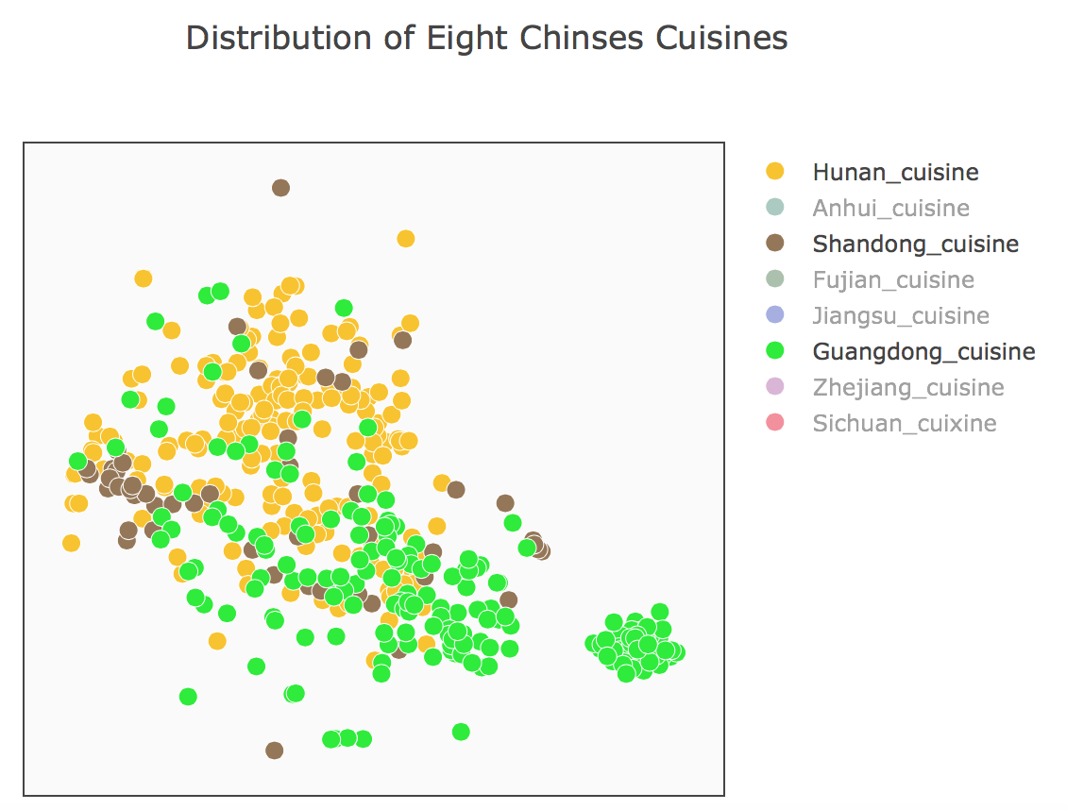
Shandong cuisine
The recipes of Shandong cuisine are closer with Hunan compared with Guangdong, which means the dishes of Shandong and Hunan have more similarity.
Unlike Wikipedia‘s description of cuisine, in our chart, Guangdong dishes which carry light diet has intersections with spicy Hunan dishes, as well as Shandong dishes which feature thick oil sauce.
Because the other four cuisines are not popular in Xiachufang, the sample is mixed with similar recipes of standing dishes, so we only compared the four popular and representative recipes.

Slide 26
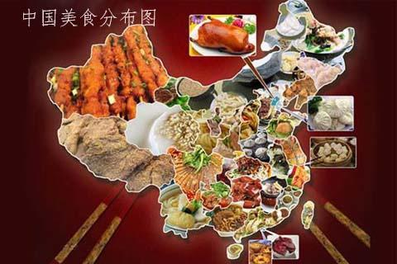
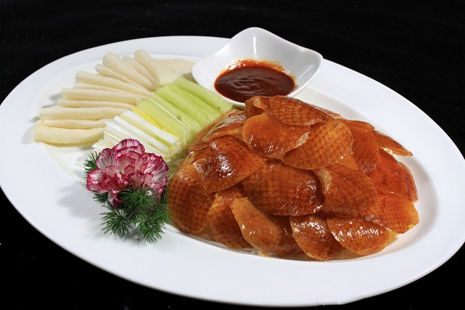
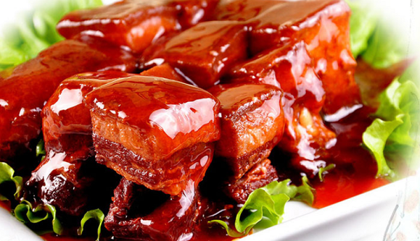
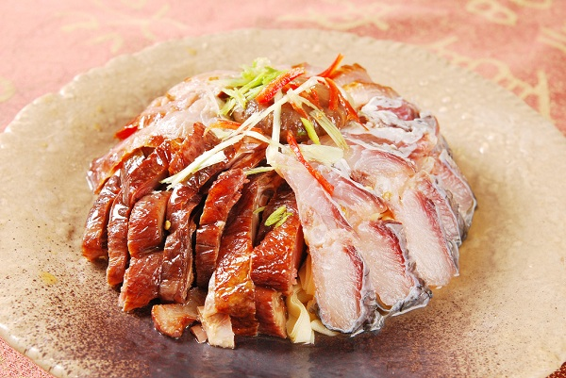
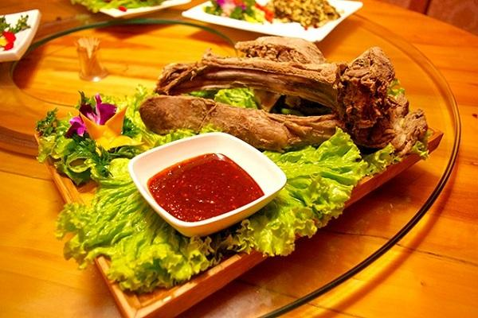
Eight Traditional Cuisines
In official definition, the difference of the eight traditional cuisines in Chinese society is quite large. Due to the differences in geography, climate, customs, and specialty products, the different local cuisine has formed different flavors.

Slide 27
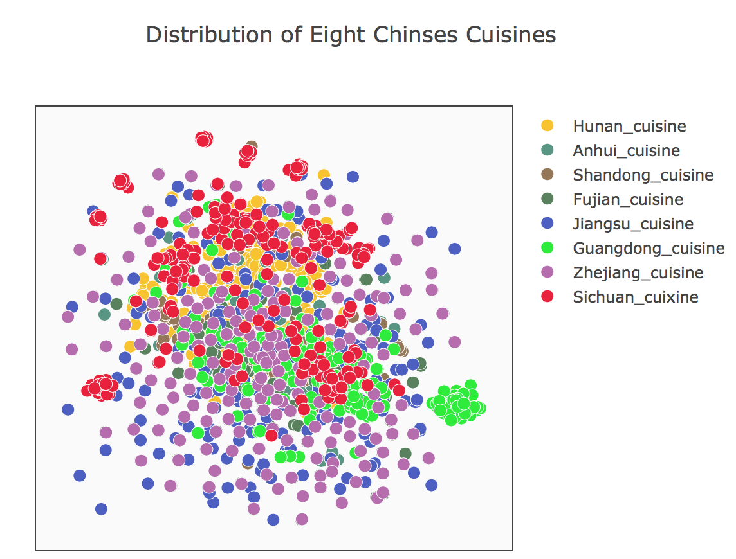
Layout of 1497 Chinese recipes from Xiachufang
But in our data, things is different, the recipes of four representative cuisine, to some extent, are closely integrated with each other, although there are still some difference.
The reason should be:
1.The recipes are posted by Xiachufang users, and the majority of them are sharing home cooking recipes, which are more convenient and simple than traditional practice.
2. The traditional cuisine categories can no longer represent the taste of the public. Because dish cuisines are always changing with time and population mobility..

Slide 28
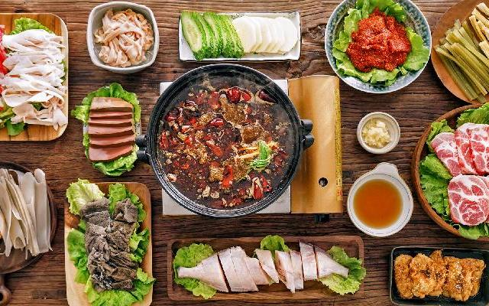


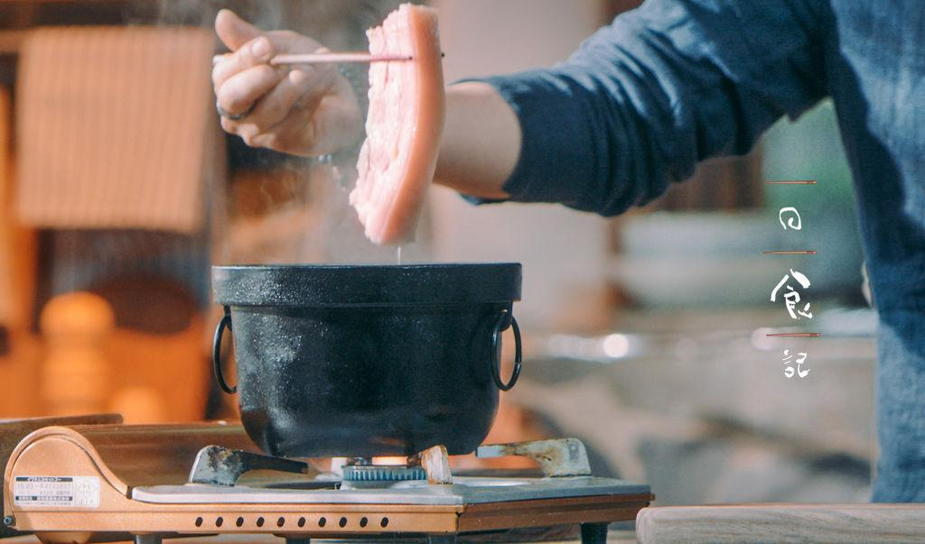
Some Clues from Data:
Brand new cuisine categories are forming or has already formed？
1.Geographic factors influence are marginalized
2.More frequent population mobility:
Go to university
Career option
3.Sharing culture

Slide 29
Thank You

Slide 30
Appendix

Slide 31
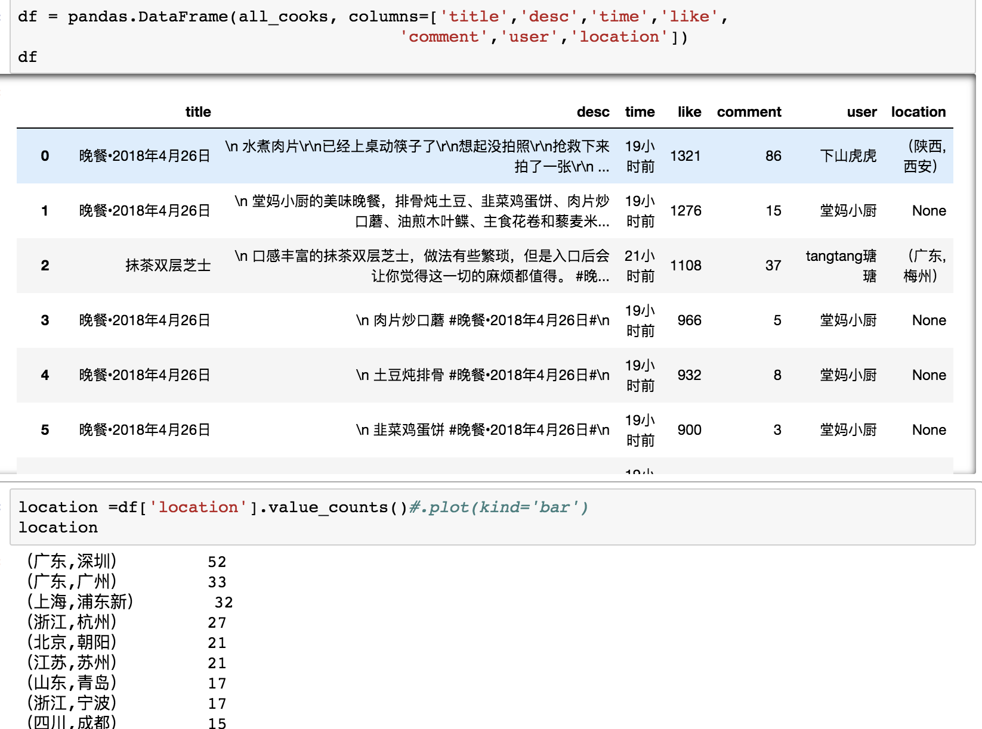
The Section 1 Code
1.We got the data from 24h popular dishes. Yet there are some missing data.
2. We did the value counts on their locations, and found that the data was too specific. We just want to calculate the provinces.

Slide 32
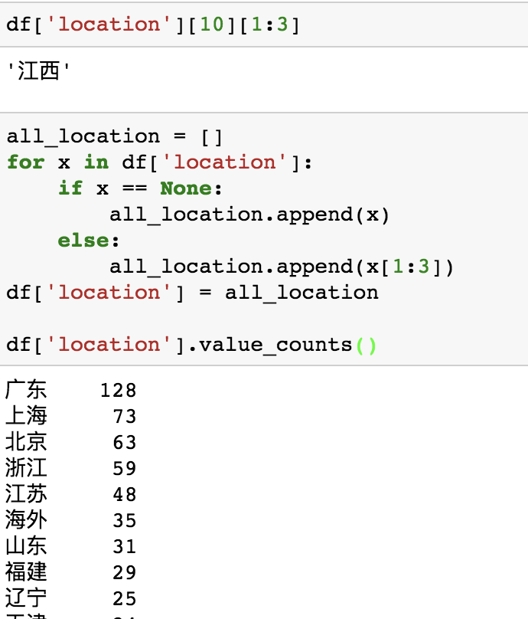
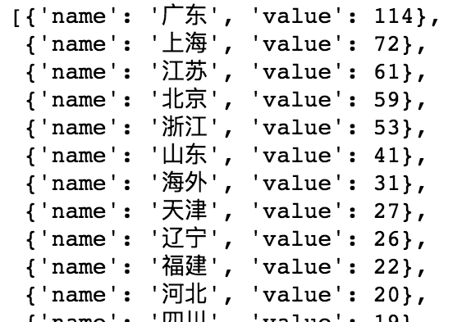
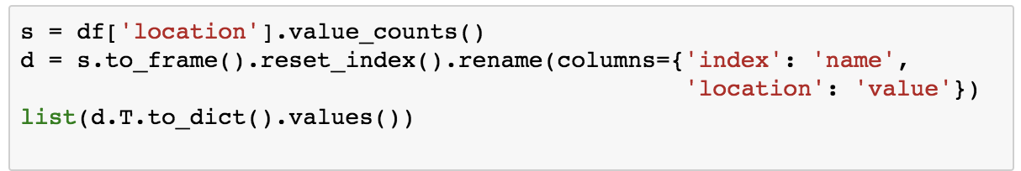
The Section 1 Code
1.We used ‘for loop’ to make a new column to reset the location data frame.
2.Then we calculate the data of each provinces in China.
3. We chose Echarts Gallery, an online visualization tool, to visualize our data.
But it needs a specific data structure
4. We reset the data structure to fits Echarts Gallery, and finally got the heat map.

Slide 33
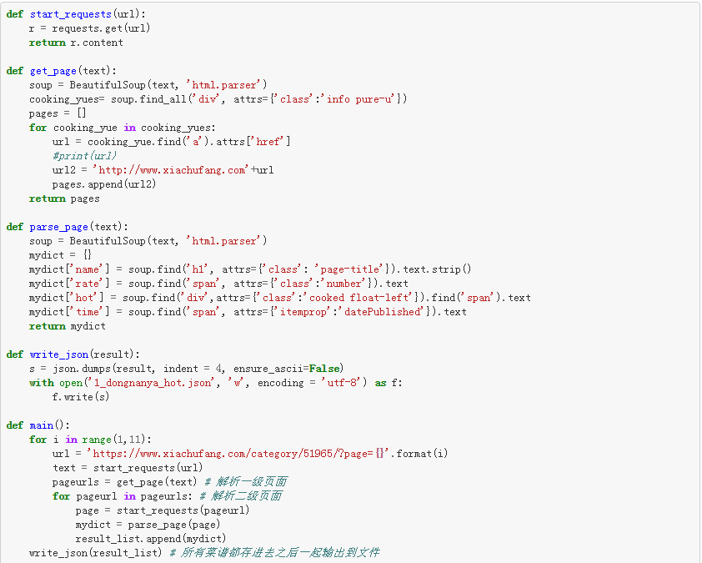
The Section 3 Code
1. Scrap data
Scrap the data from Xiachufang Website in terms of Southeast Asian, Korean, Japanese and Western recipes, each including recipe's name, uploaded time, rate and hot (the number of people that has cooked the same recipe). Each kind of recipes has 10 pages, totally up to 800 recipes.
def: get the secondary subordinate page
def: find the details in the page
def: write into json
get 10 pages
and use above defs

Slide 34
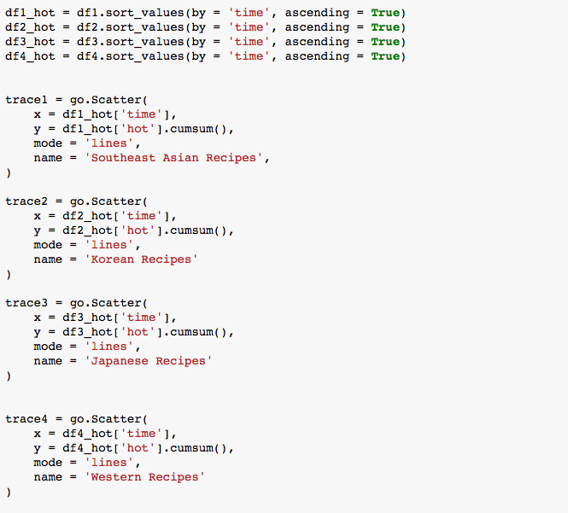
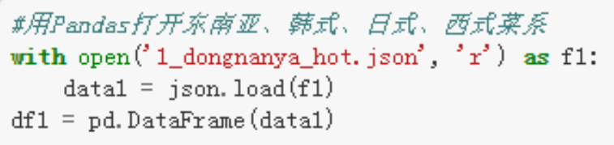
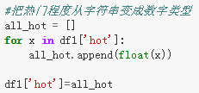
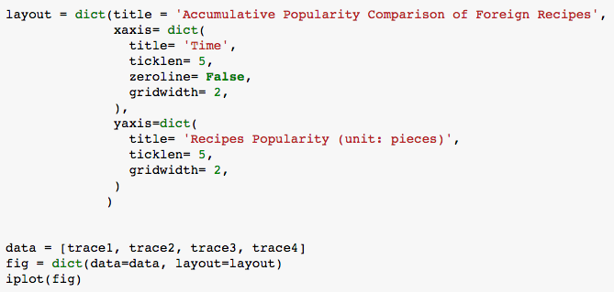
The Section 3 Code
2. Use Pandas to open data
4. Draw
According to the time order, draw the accumulative popularity of four kinds of recipes.
3. Clean data: change the str type in df1['hot'] into the float type so that it can be sorted.

Slide 35
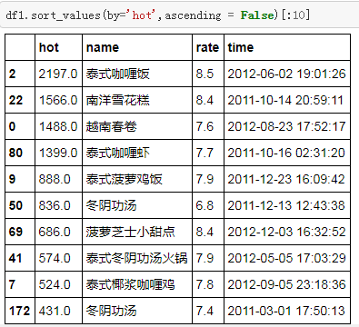
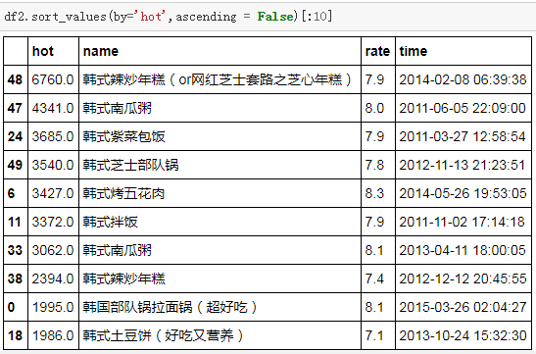


东南亚、韩式、日式、西式菜谱年度十大热门菜谱
The Top 10 Popular Southeast Asian, Korean, Japanese and Western Recipes

